Slide 1
Voltage Regulator
Using LM317

Slide 2
Applied physics project presentation Dr. Jamal Nasir MAM Tehniyyat

Slide 3
Project done by
Sheryar Ahmed
Muhammad Hassan
From BCE-1B

Slide 4
Contents
What is voltage regulator?
How It work.
Purpose, application
What have we learned form this?

Slide 5
What is voltage regulator?

Slide 6







Voltage regulator: voltage regulator, any electrical or electronic device that maintains the voltage of a power source within acceptable limits.

Slide 7
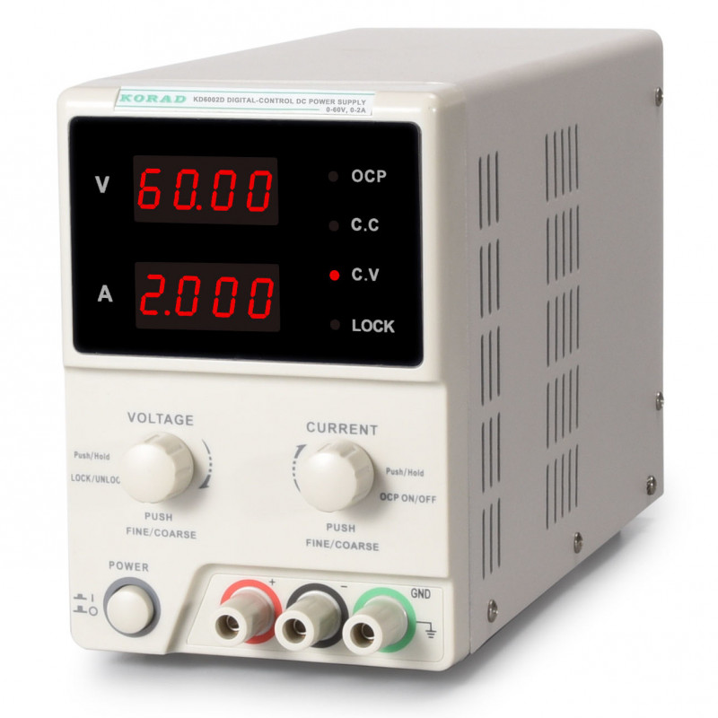



Example: our lab power supply we can use this power supply for different purpose by changing its current and voltage of our use

Slide 8
How it work.

Slide 9

How it work? You notice first it lower the voltage, convert the AC to DC and then it control the voltage

Slide 10
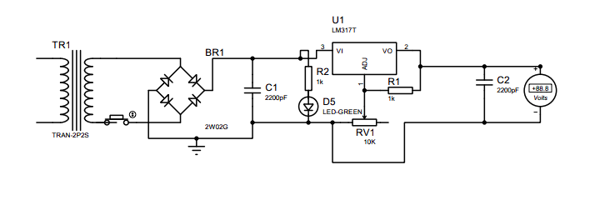

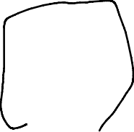
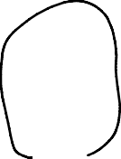
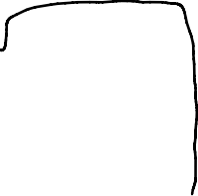


Slide 11
Purpose and application.

Slide 12
Purpose The purpose of this device is providing the variable voltage to the other electrical device let say we want to charge the AAA battery(1.5v) we only need 1.5v to charge not much higher not much lower otherwise it will damage the battery

Slide 13
Application There are many applications of voltage regulators. One of the most common examples is the mobile charger. The adapter is supplied with an AC signal. However, the output voltage signal is a regulated DC signal. Every power supply in the world uses a voltage regulator to provide the desired output voltage. Computers, televisions, laptops and all sorts of devices are powered using this concept.

Slide 14
What have we learned form this?

Slide 15
Concepts how transformer work conversion of AC to DC idea behind the voltage control how phone and different devices use this technology

Slide 16
So, any Questions feel free to ask?

Slide 17
Alright thank you so much for your attention have a great day

